Slide 1

Will individual player stats increase the accuracy in the prediction of match results of the English Premier League?
Problem Statement

Slide 2
Objective
To Increase the Accuracy of Predicting the Results of Soccer Matches of the EPL based on Team and Individual Player Data Using an Artificial Neural Networks

Slide 3
Premier League
English Soccer League
One of the most watched in the world.
Has been named the best league in the world three years in a row.
20 Teams
380 games each season
1 winner based on points
Promotion and relegation

Slide 4
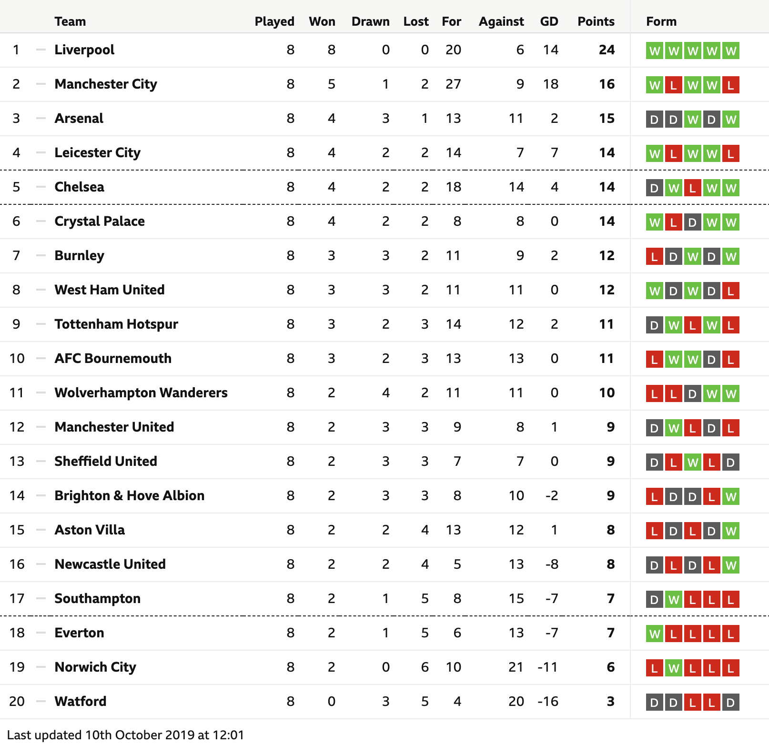

Slide 6
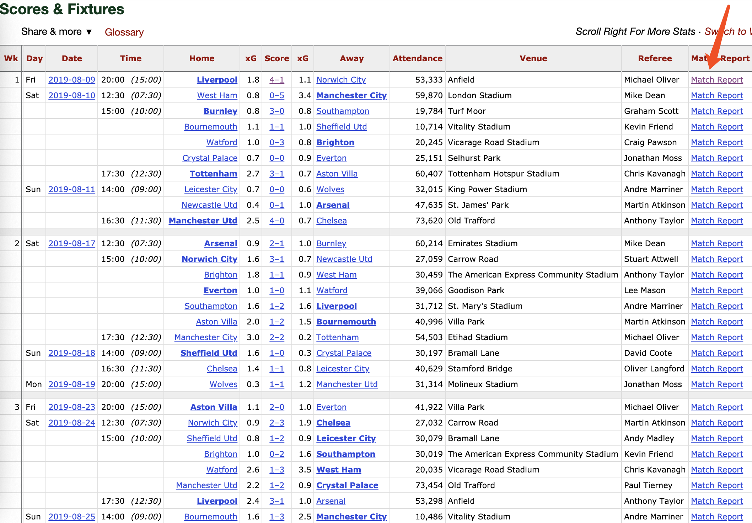
Source: https://fbref.com/en/comps/9/schedule/Premier-League-Fixtures

Slide 7
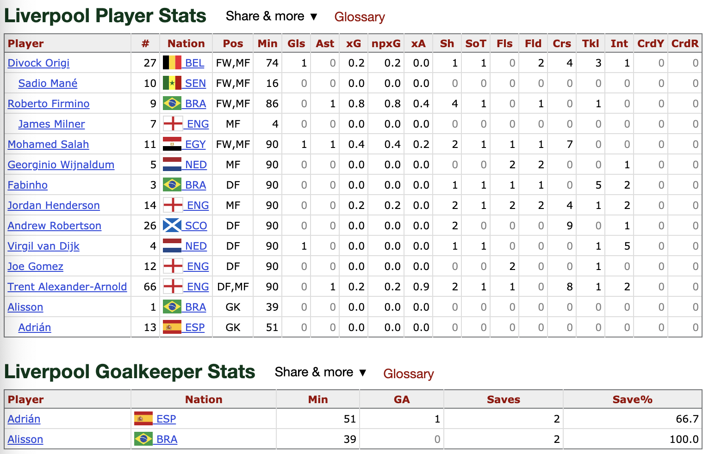
Source: https://fbref.com/en/matches/928467bd/Liverpool-Norwich-City-August-9-2019-Premier-League

Slide 8
Variables
Min = Minutes
Gls = Goals
Asi = Assists
Sh = Shots
SoT = Shots on Target
Fls = Fouls Committed
Fld = Fouls Drawn
Crs = Crossed
Tkl = Tackles Won
Int = Interceptions
CrdY = Yellow Card
CrdR = Red Card
GA = Goals Against
Saves = Saves
Saves% = Saves percentage
Avg Home Goals
Avg Against Home Goals
Avg Away Goals
Avg Against Away Goals
Avg Home Points
Avg Away Points

Slide 9
Artificial Neural Network
Neural networks are a set of algorithms, modeled loosely after the human brain, that are designed to recognize patterns. They interpret sensory data through a kind of machine perception, labeling or clustering raw input.
They help to group unlabeled data according to similarities among the example inputs, and they classify data when they have a labeled dataset to train on.

Slide 10
Artificial Neural Network
20 Layers, 30 Nodes, 30 Runs
R package: h2o
It took 24 hours to run the neural network.

Slide 11
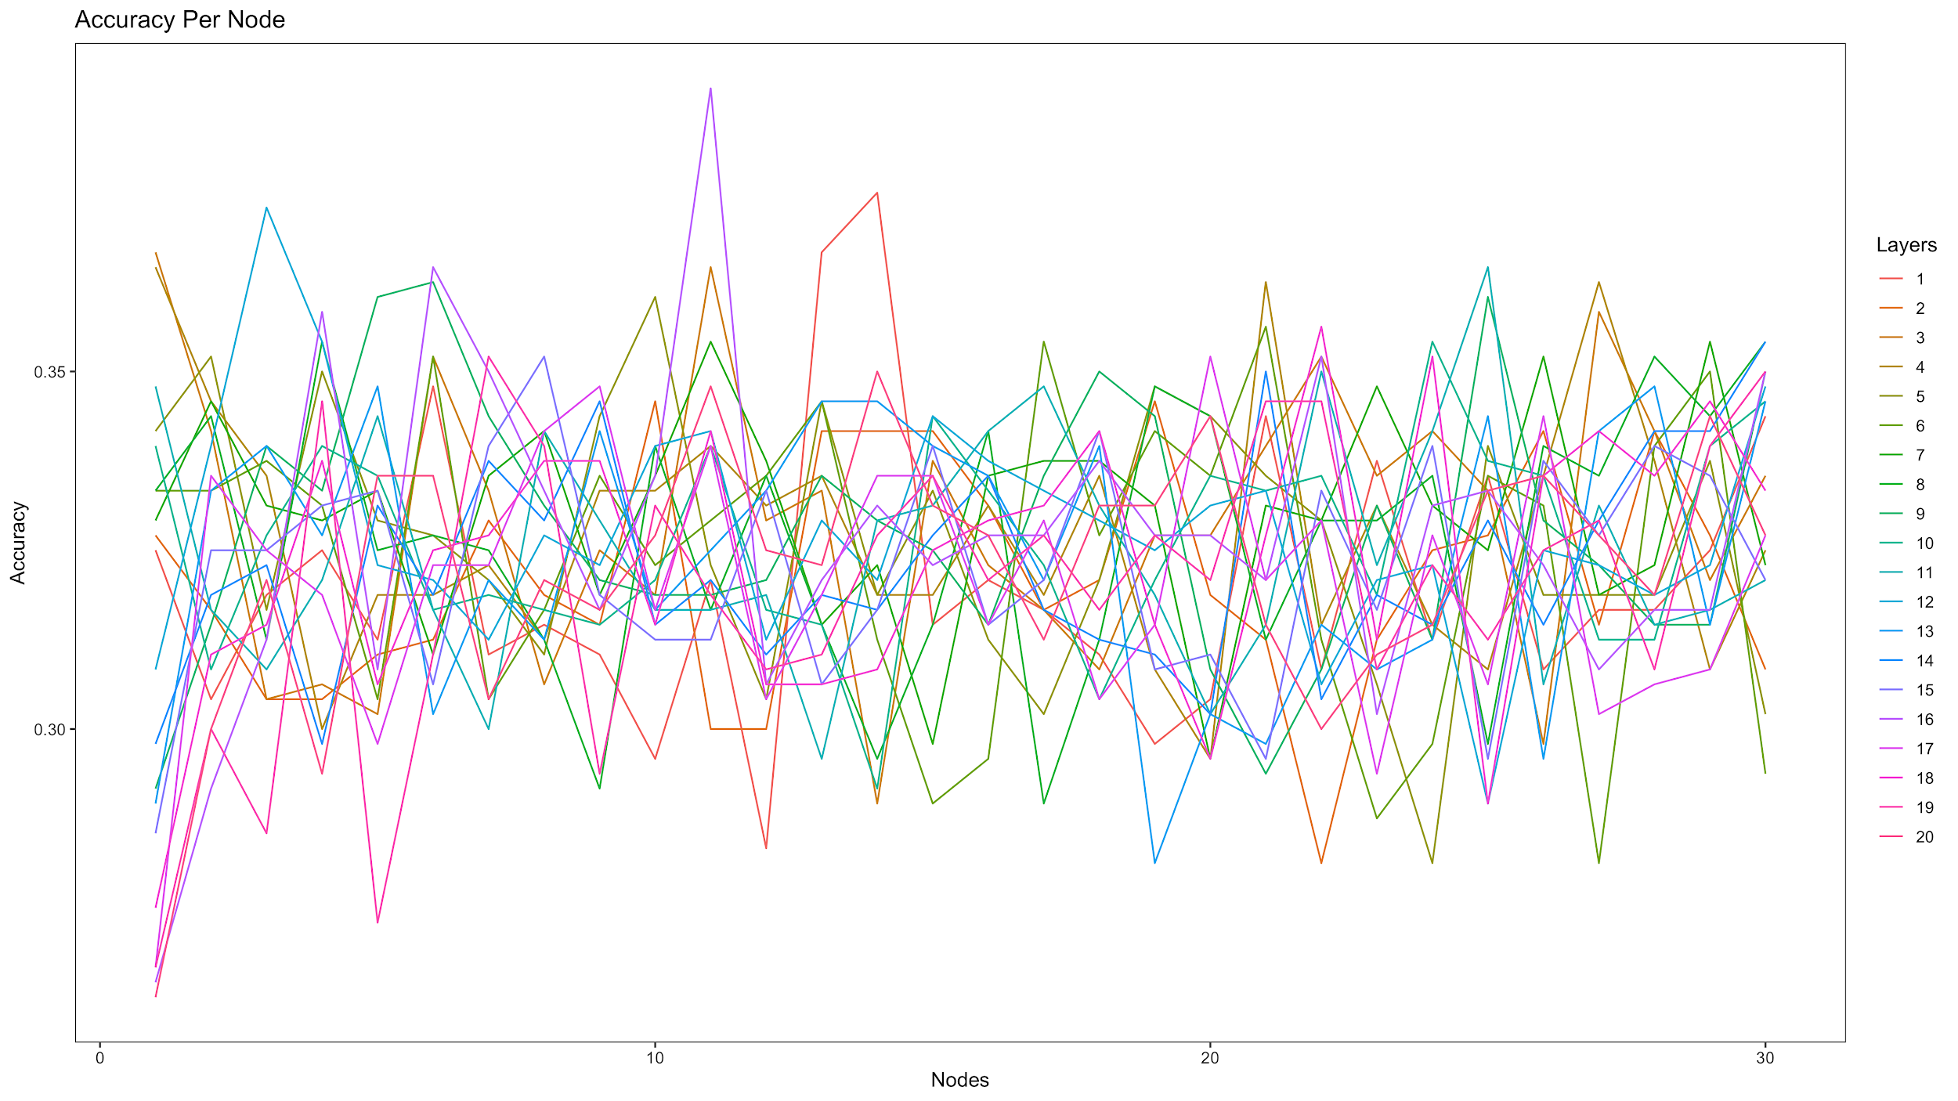

Slide 13
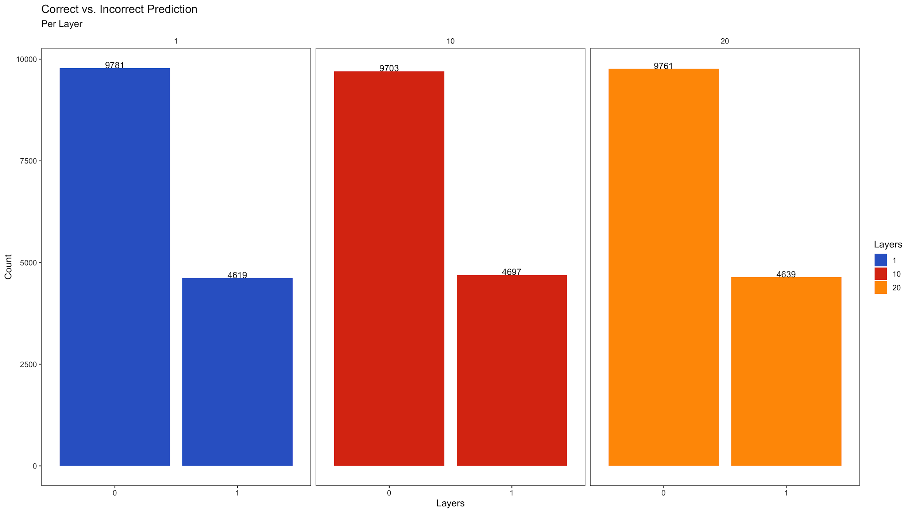

Slide 14
Results
93,534 Correct Predictions
288,000 Attempts
Highest Accuracy : 68.75%
The model also predicts that Arsenal is going to win the championship this and next season in a row.

